Slide 1


Wootz Steel
Ancient Indian Metallurgy and the Science Behind It
Presenter : Aryan Vijayrao Sune
PRN : 255109005
Branch : SY CSE(Un) Btech
College : Walcahnd College of Engineering Sangli

Slide 2
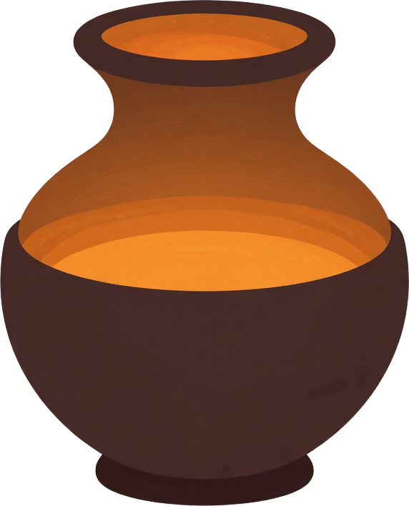

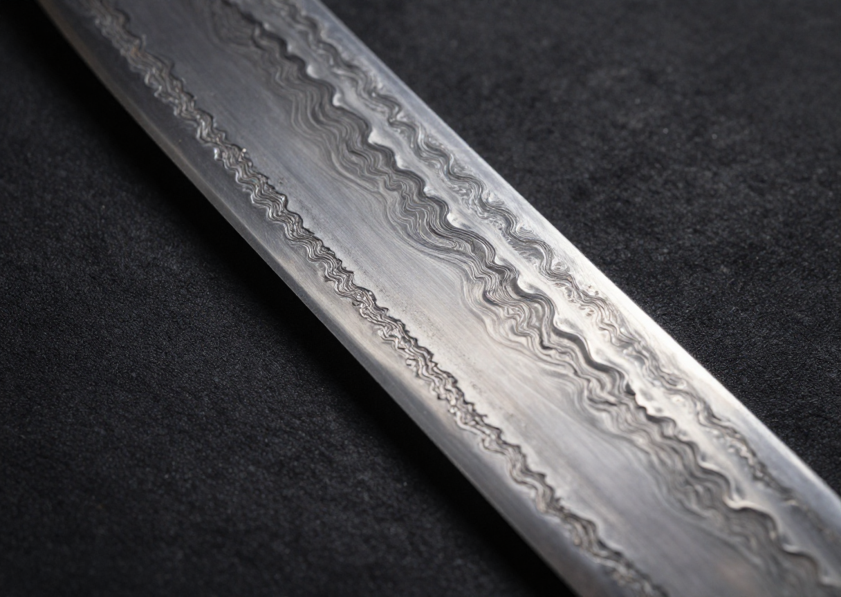
What Was Wootz Steel?
High-carbon crucible steel originating in South India
Known for exceptional strength and distinctive surface patterns
Produced using sealed clay crucibles with controlled heating
Traded widely across the ancient world beyond India
By : Aryan Sune

Slide 3
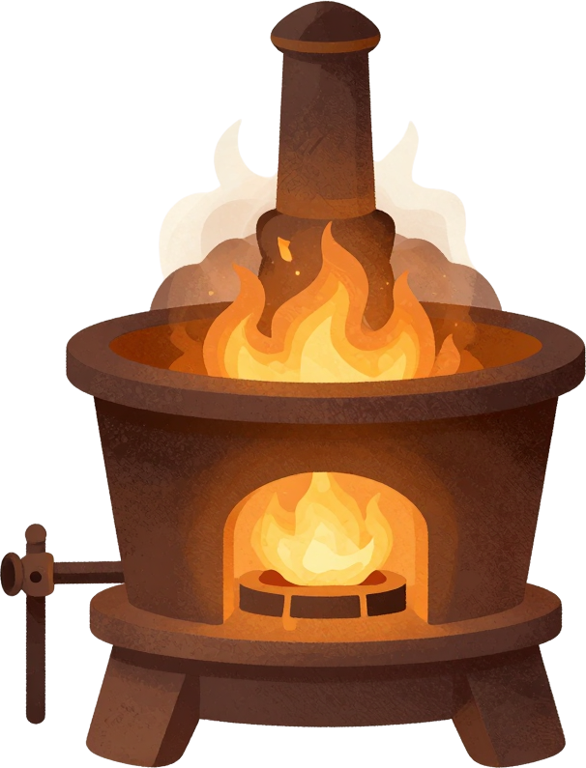

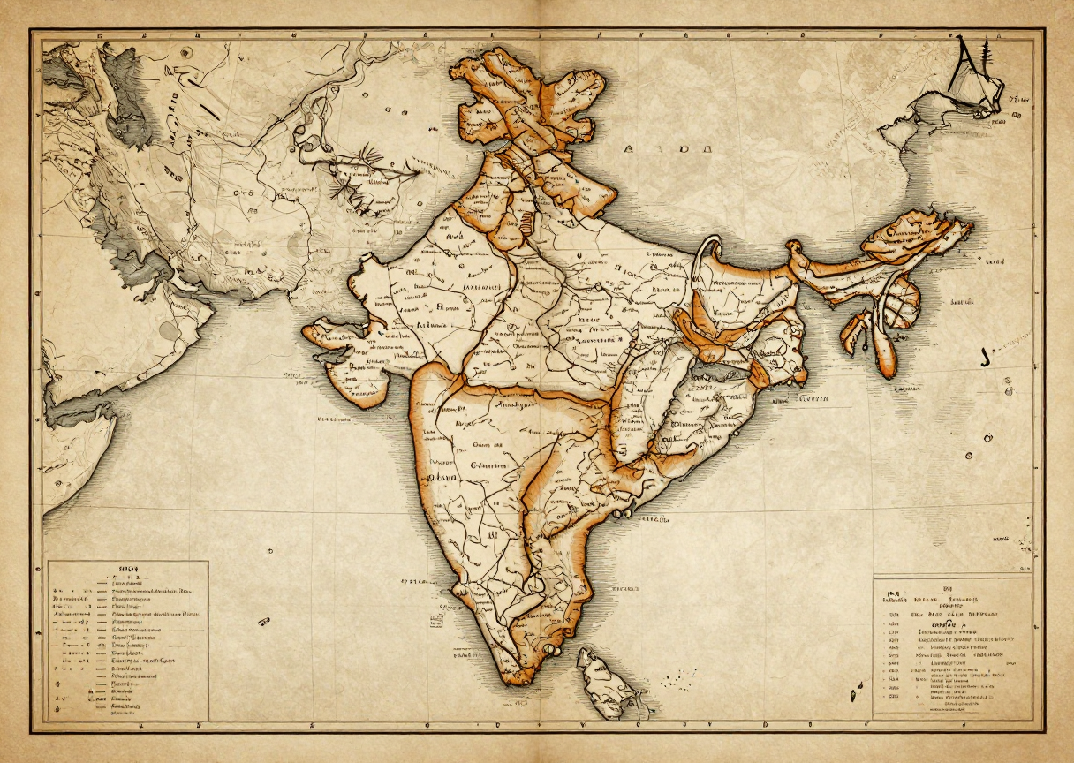
Historical Background
Ancient origins dating to early historic periods; major production regions in South India including Tamil Nadu and Andhra Pradesh; evidence from archaeological finds and historical texts.
Widely exported across the Middle East, Europe, and Asia; praised in historical accounts for superior quality; established India's international reputation in metallurgy.
By : Aryan Sune

Slide 4
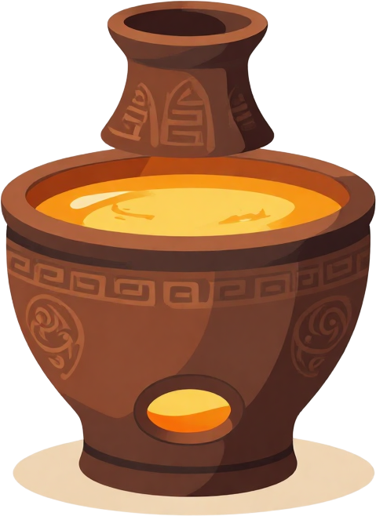

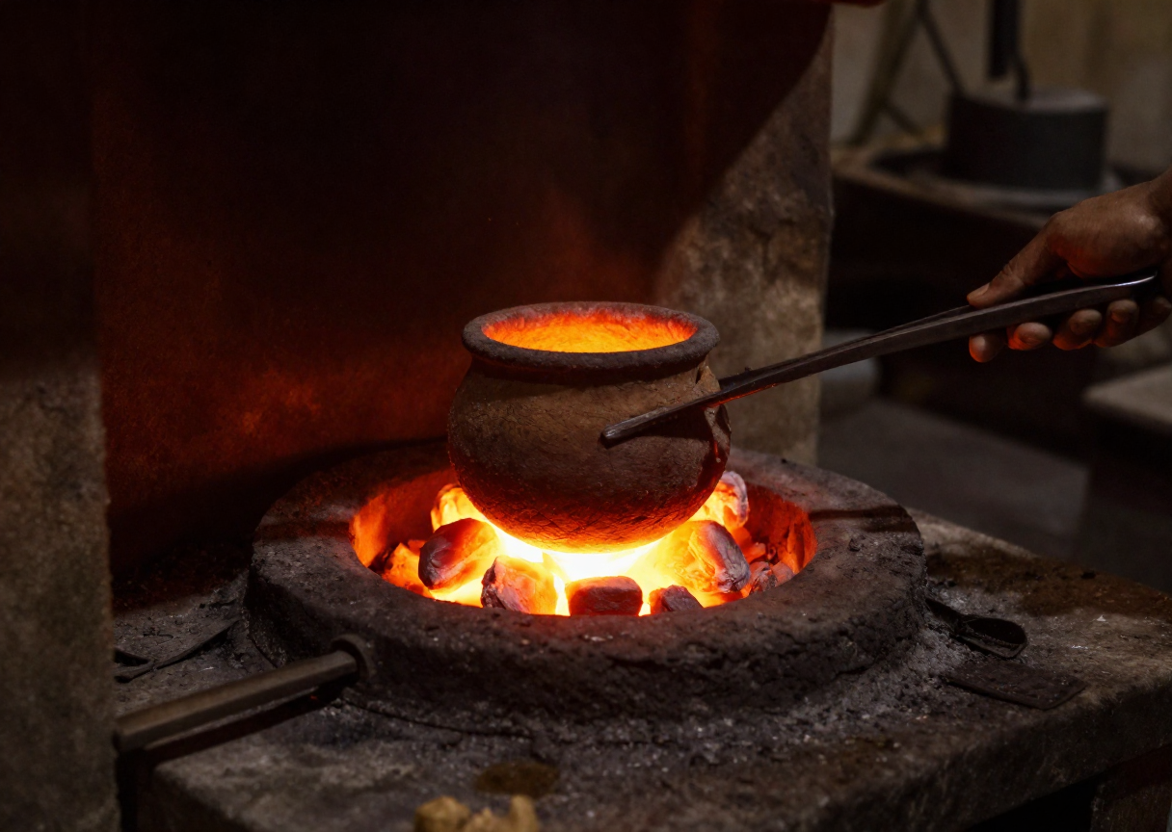
How Was Wootz Made?
  Iron/steel feedstock + carbon source (wood, leaves)
  Sealed clay crucible — controlled atmosphere
  High-temperature heating in a furnace
  Slow, controlled cooling to form carbides
  Forging and shaping the solid ingot
Wootz Steel: Ancient Indian Metallurgy
By : Aryan Sune

Slide 5
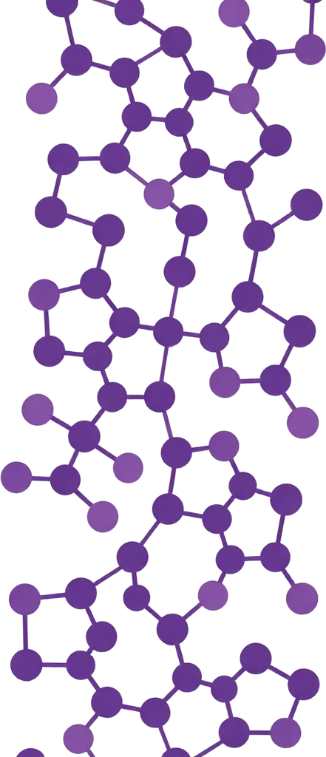


The Science of Carbon
Iron combined with controlled carbon content determines steel's properties. Carbon increases hardness and strength, but too little or too much carbon degrades performance. The Wootz process required precise control of carbon levels throughout heating and cooling. Traditional Indian smiths achieved this balance through accumulated empirical knowledge, long before modern metallurgy explained the underlying science.
By : Aryan Sune

Slide 6

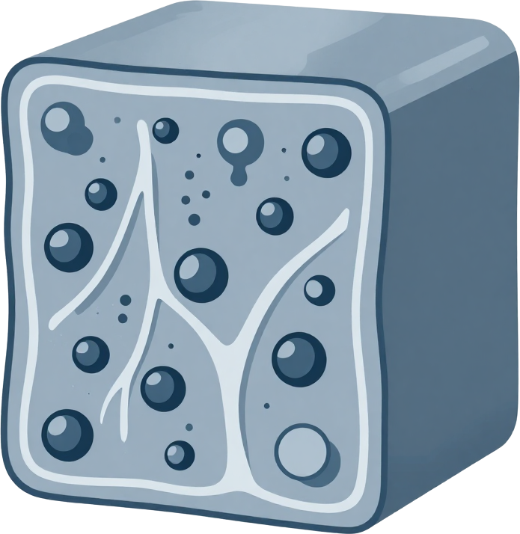
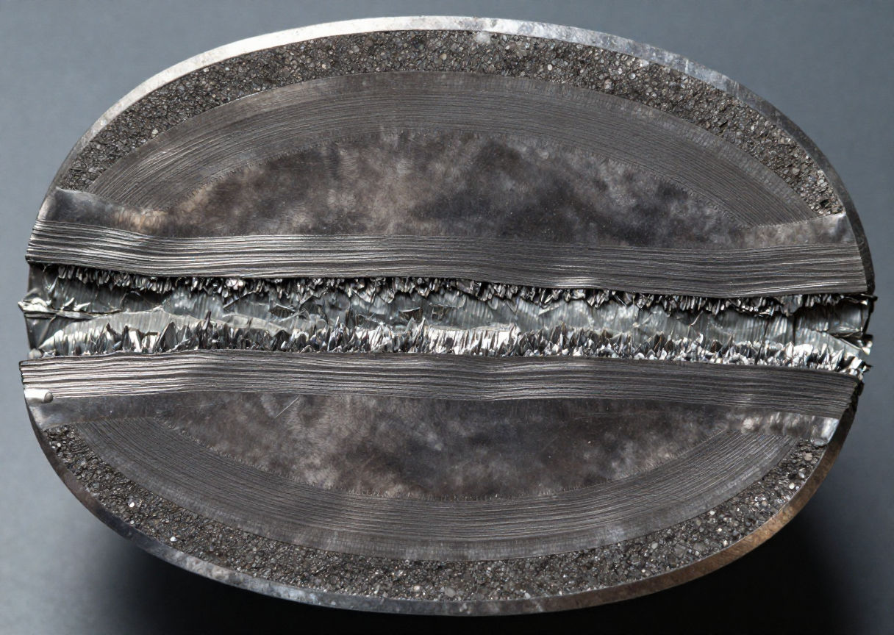
Microstructure: The Hidden Science
• Carbide bands form during slow cooling of high-carbon steel
• Steel microstructure determines hardness and toughness
• Heat treatment and cooling rate control grain structure
• Pattern development on blade surface reflects internal microstructure
By : Aryan Sune

Slide 7


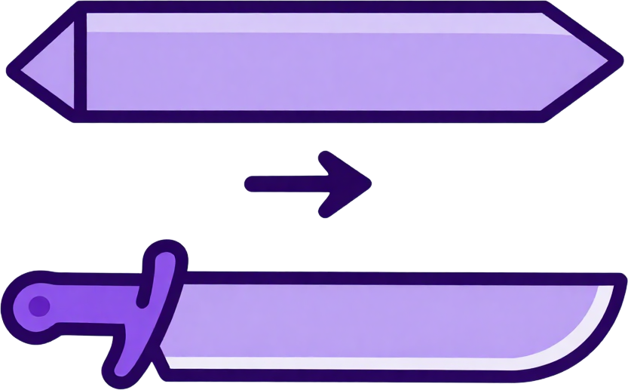
Wootz Steel: Ancient Indian Metallurgy
From Wootz to Famous Blades
• Wootz ingots were exported across trade routes
• Blades were forged by specialist smiths
• Damascus blades became associated with distinctive wavy patterns
• Material quality depended on careful processing
• Indian production and later forging traditions were distinct stages
By : Aryan Sune

Slide 8





Final Defense Session 2026
Why Was It Technologically Important?
By : Aryan Sune

Slide 9
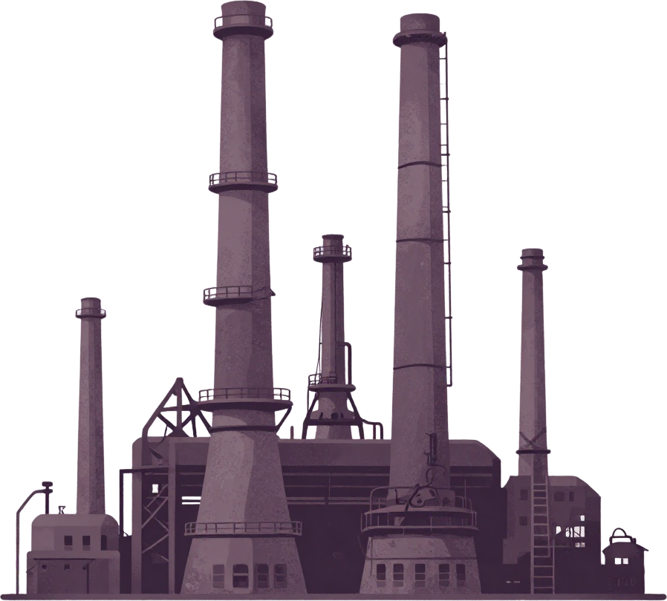

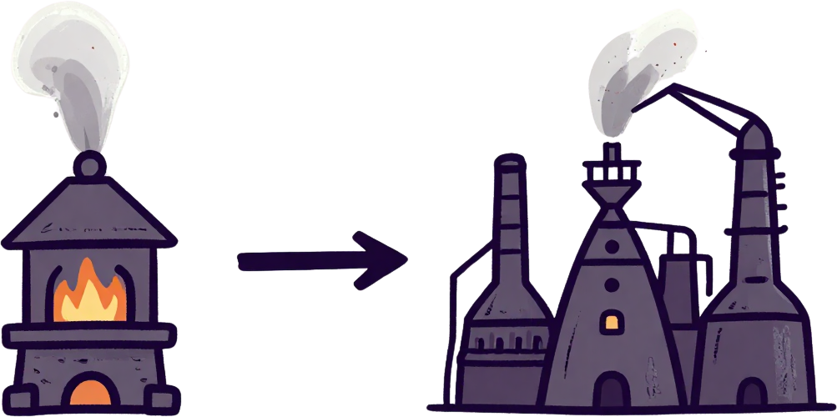
Decline of the Wootz Tradition
Colonial-era economic disruptions replaced traditional craft industries; industrial steelmaking offered mass production at lower cost, eliminating demand for artisanal Wootz steel.
Specialist knowledge of crucible techniques was held by small communities; as production ceased, the precise methods for controlled carbon content and slow cooling were gradually lost.
By : Aryan Sune

Slide 10
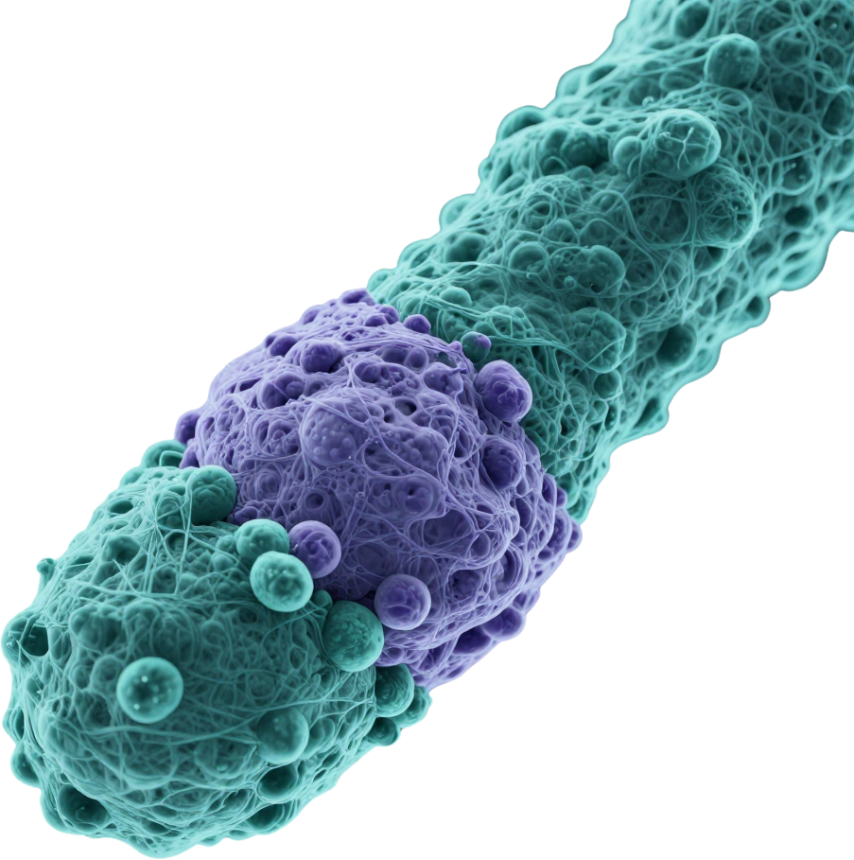


What Modern Science Can Learn From It
• Materials characterization of ancient samples
• Microstructure–property relationships
• Sustainable traditional technologies
• Heritage science and conservation
• Inspiration for modern materials research
By : Aryan Sune

Slide 11



Key Takeaways
Wootz steel was a real, advanced metallurgical technology.
Carbon content and controlled processing were the crucial factors behind its exceptional properties.
Microstructure explains the material's hardness, toughness, and distinctive surface patterns.
History and science complement each other; traditional knowledge deserves evidence-based study.
By : Aryan Sune

Slide 12



Wootz Steel: Ancient Indian Metallurgy
Thank You
Questions & Discussion
Name : Aryan Vijayrao Sune
PRN : 255109005
Branch : SY CSE(Un) Btech
College : Walchand College of Engineering Sangli

